Slide 1
C# project: LEGO® analogy Project MEGO
Oleksii Kosobutskyi and Adam Czub

Slide 2

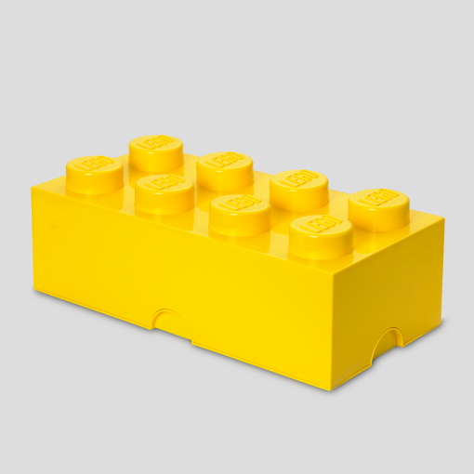
Rewind
https://commons.wikimedia.org/wiki/File:Official_unity_logo.png
Application written in Unity environment
Creative game
MEGO: interactive possibility of playing with LEGO without real blocks
Designing tool
Great fun for kids and adults
https://roomcopenhagen.com/wp-content/uploads/2014/02/4004-LEGO-Storage-Brick-8-Bright-Yellow-510x510.png

Slide 3
Achievements
Created simple world
First Person Sight (FPS) game
Posibility of movement
Blocks building
Switchable building mode

Slide 4
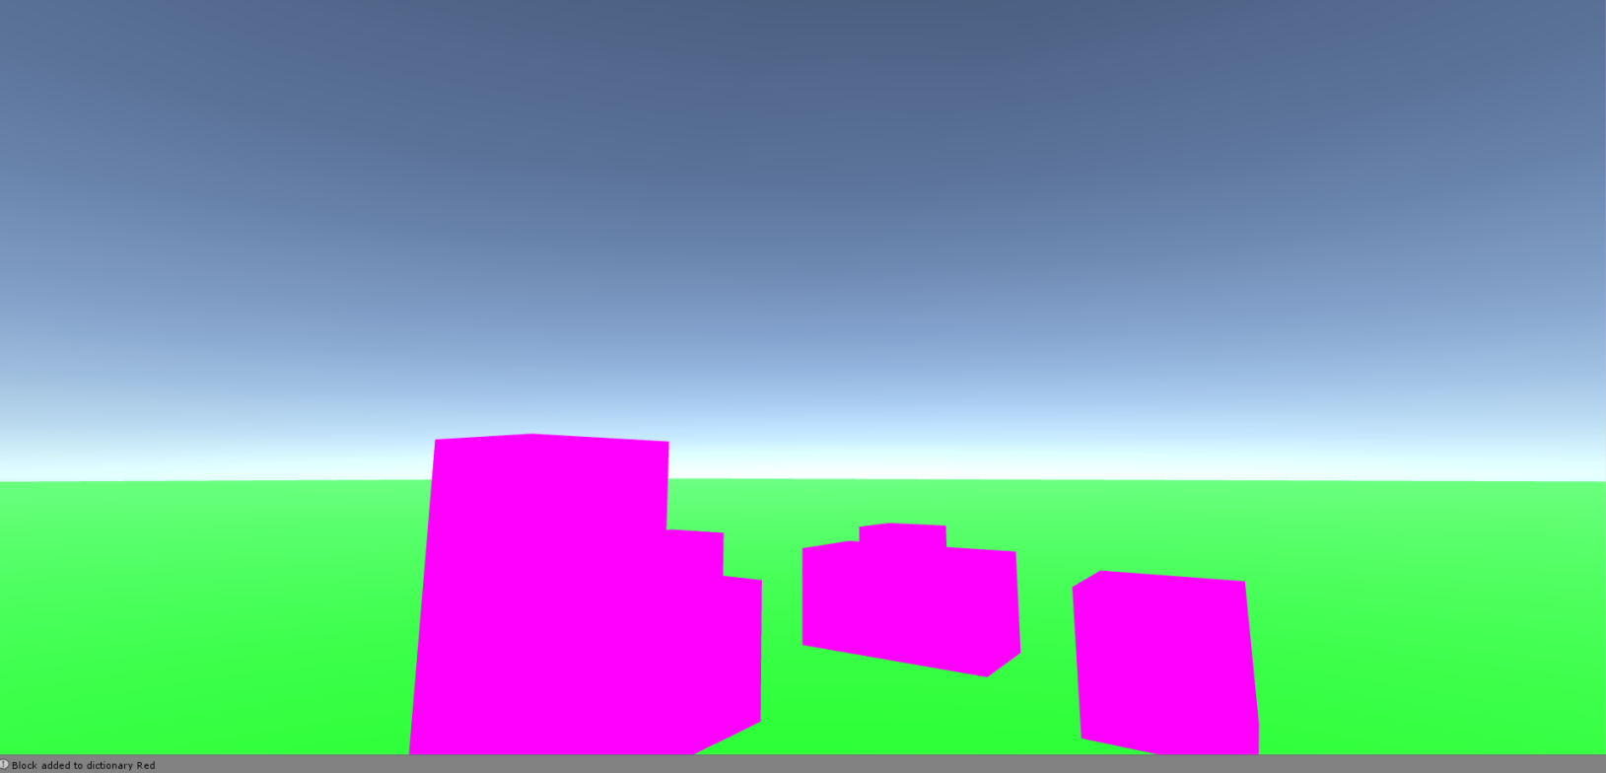


Slide 5
To do
Change perspective to „perspective” mode (not isometric)
Introduce zooming option
Introduce possibility of changing block colors and deleting blocks
Active selection menu for block color or shape choosing
Program .exe file

Slide 6
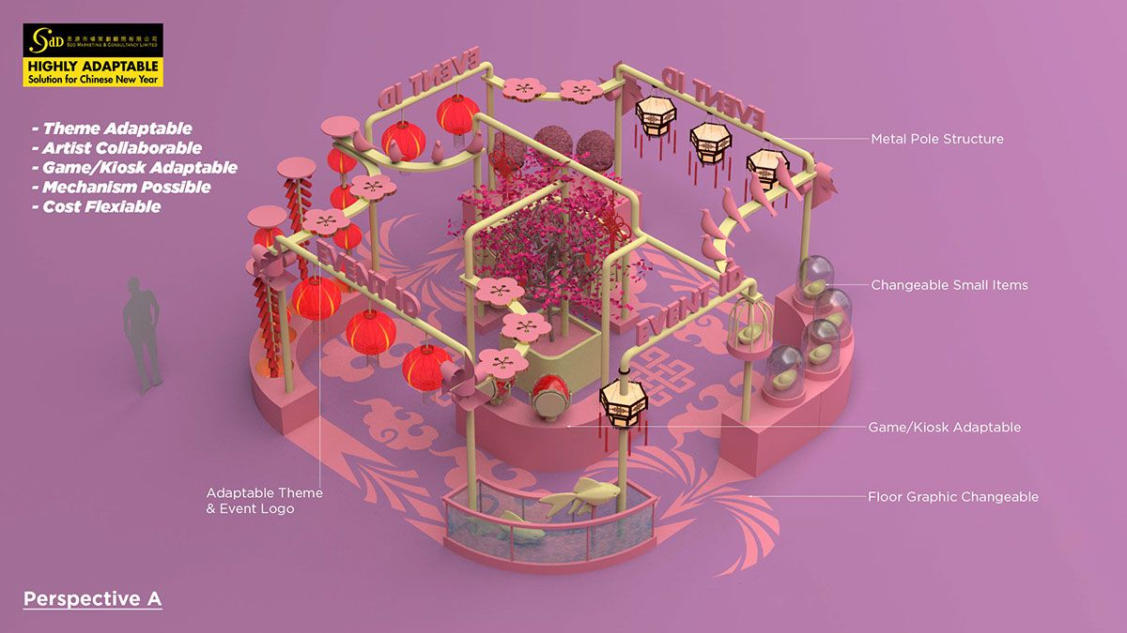
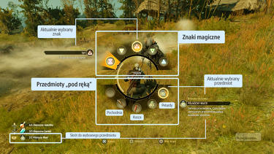
Perspective
Active menu
https://i.pinimg.com/originals/44/72/87/44728736640ef430349608ac248acc8e.jpg
https://d2skuhm0vrry40.cloudfront.net/2013/articles//a/1/7/5/4/8/2/6/kolo_szybkiego_wyboru_wiedzmin.jpg.jpg/EG11/resize/375x-1/quality/75/format/jpg

Slide 7
Thank you for your attention
Have a nice day ☺

